Slide 1


<Name>
<Date>

Slide 2

Outline
Executive Summary
Introduction
Methodology
Results
Conclusion
Appendix

Slide 3
Executive Summary
Summary of methodologies
Summary of all results

Slide 4
Introduction
Project background and context
This capstone project focuses on the commercial space industry, specifically on SpaceX’s cost-effective rocket launches. I assumed the role of a data scientist working for SpaceY, a new competitor founded by billionaire Allon Mask The primary objective of this project is to determine the price of each rocket launch and predict whether SpaceX will reuse the first stage of its rockets.
Problems to find answers to
Predicting First Stage Reuse
What factors influence whether the first stage of the rocket will be reused?
Can a machine learning model accurately predict the likelihood of first-stage reuse based on these factos?
Data Gathering and Cleaning
How can data to answer these questions be found and what steps need to be taken to make it useable by ML algorithms?
Presentation
How can Findings be presented in a concise and easy to understand way?

Slide 5

Section 1

Slide 6
Methodology
Executive Summary
Data collection methodology:
Perform data wrangling
Perform exploratory data analysis (EDA) using visualization and SQL
Perform interactive visual analytics using Folium and Plotly Dash
Perform predictive analysis using classification models

Slide 7
Data Collection
Data was collected in two ways
Through the spacexdata.com api, cleaned, and saved to csv source: https://api.spacexdata.com/v4/rockets/
Through webscraping with BeautifulSoup from Wikipedia source: https://en.wikipedia.org/w/index.php?title=List_of_Falcon_9_and_Falcon_Heavy_launches

Slide 8
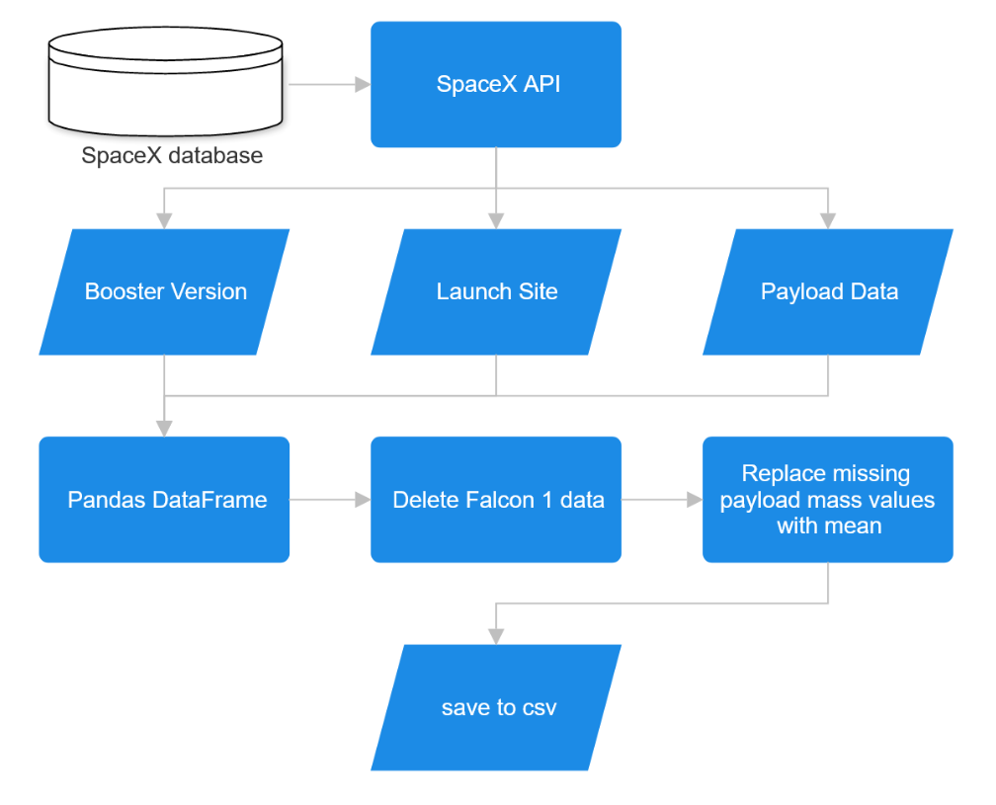
Data Collection – SpaceX API
Data can be obtained via the public SpaceX API
Collect and clean data like shown in flowchart
GitHub URL of the completed SpaceX API calls notebook https://github.com/elmi3/ibm_capstone/blob/main/jupyter-labs-spacex-data-collection-api.ipynb

Slide 9
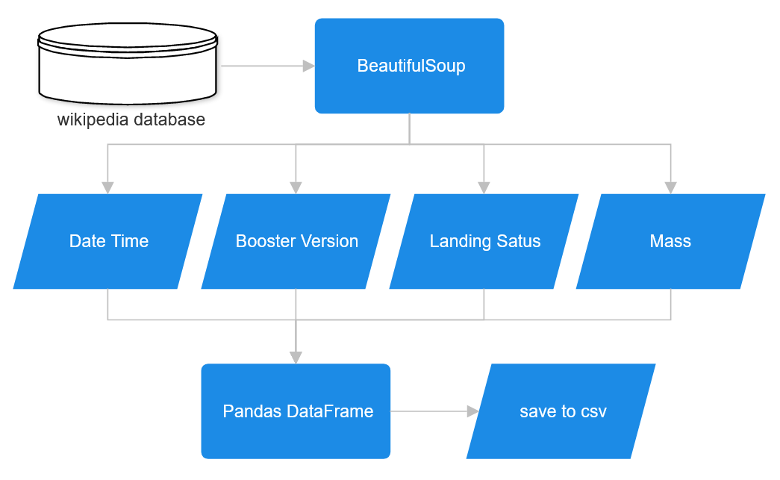
Data Collection - Scraping
Alternatively, data can be obtained from wikipedia.org
Data is downloaded and processed via BeautifulSoup like shown in flowchart
GitHub URL of the completed webscraping notebook https://github.com/elmi3/ibm_capstone/blob/main/jupyter-labs-webscraping.ipynb

Slide 10
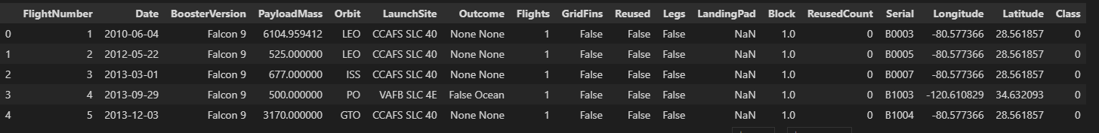
Data Wrangling
Some initial EDA was performed, consisting of:
Calculating the number of launches on each site
Calculating the number and occurrence of each orbit
Calculating the number and occurrence of mission outcome of the orbits
Then a landing outcome label was created and added to the DataFrame this is necessary for ML training in the following chapters
GitHub URL of the completed data wrangling notebook https://github.com/elmi3/ibm_capstone/blob/main/labs-jupyter-spacex-Data%20wrangling.ipynb

Slide 11
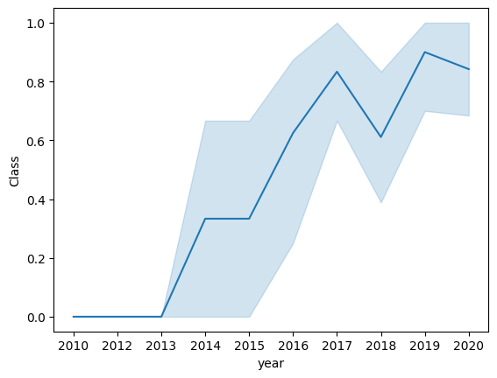
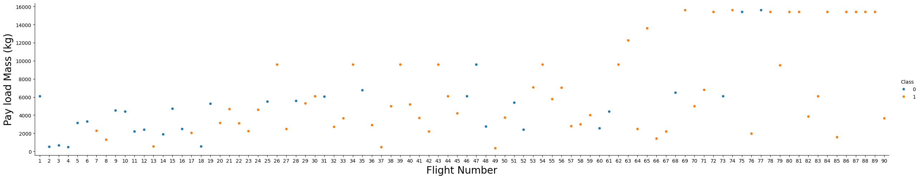
EDA with Data Visualization
Graphical EDA consisted of several visualizations, like:
Increase of successful launches since 2010 (right)
Increase in Payload Mass over the program’s duration (bottom)
GitHub URL of the completed data visualization notebook https://github.com/elmi3/ibm_capstone/blob/main/jupyter-labs-eda-dataviz.ipynb

Slide 12
EDA with SQL
List of performed SQL queries:
names of the unique launch sites in the space mission
5 records where launch sites begin with the string ‘CCA’
total payload mass carried by boosters launched by NASA (CRS)
average payload mass carried by booster version F9 v1.1
date when the first successful landing outcome in ground pad was achieved
names of the boosters which have success in drone ship and have payload mass greater than 4000 but less than 6000
total number of successful and failure mission outcomes
names of the booster_versions which have carried the maximum payload mass
month names, failure landing_outcomes in drone ship, booster versions, launch_site for 2015
landing outcomes between 2010-06-04 and 2017-03-20 in descending order
GitHub URL of the completed EDA with SQL notebook https://github.com/elmi3/ibm_capstone/blob/main/jupyter-labs-eda-sql-coursera_sqllite.ipynb

Slide 13
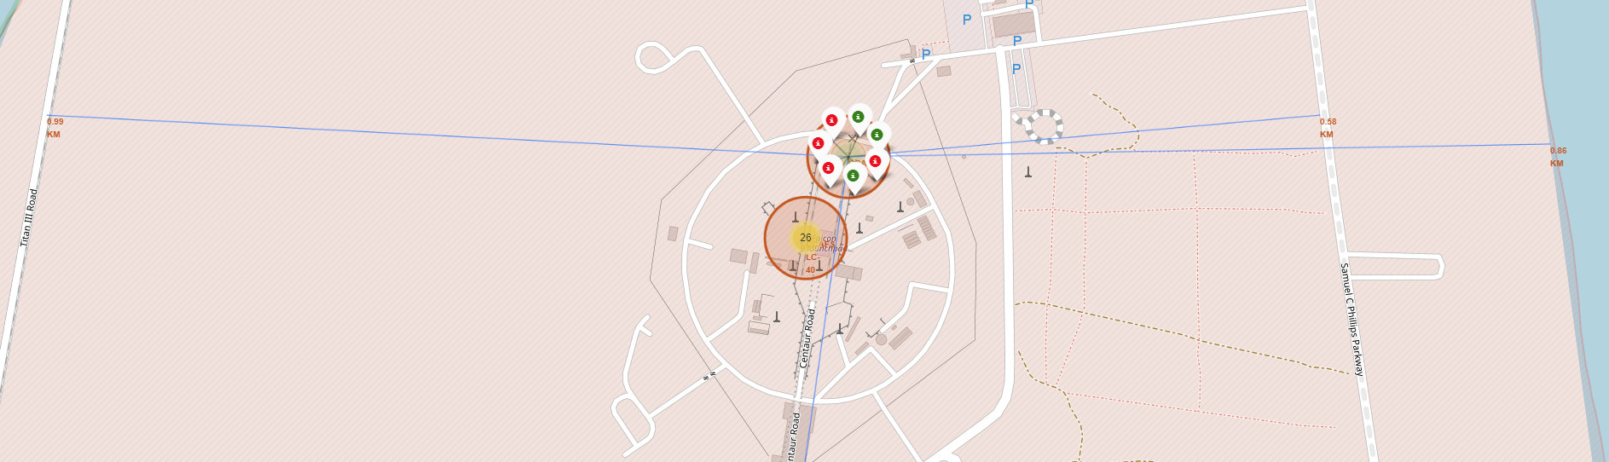
Build an Interactive Map with Folium
Folium maps was used, including markers, circles, lines, and marker clusters to show
The area of launch sites (circles)
Launch sites (markers)
Launches (marker clusters)
Distances between points (lines)
GitHub URL of the completed interactive map notebook https://github.com/elmi3/ibm_capstone/blob/main/lab_jupyter_launch_site_location.ipynb

Slide 14
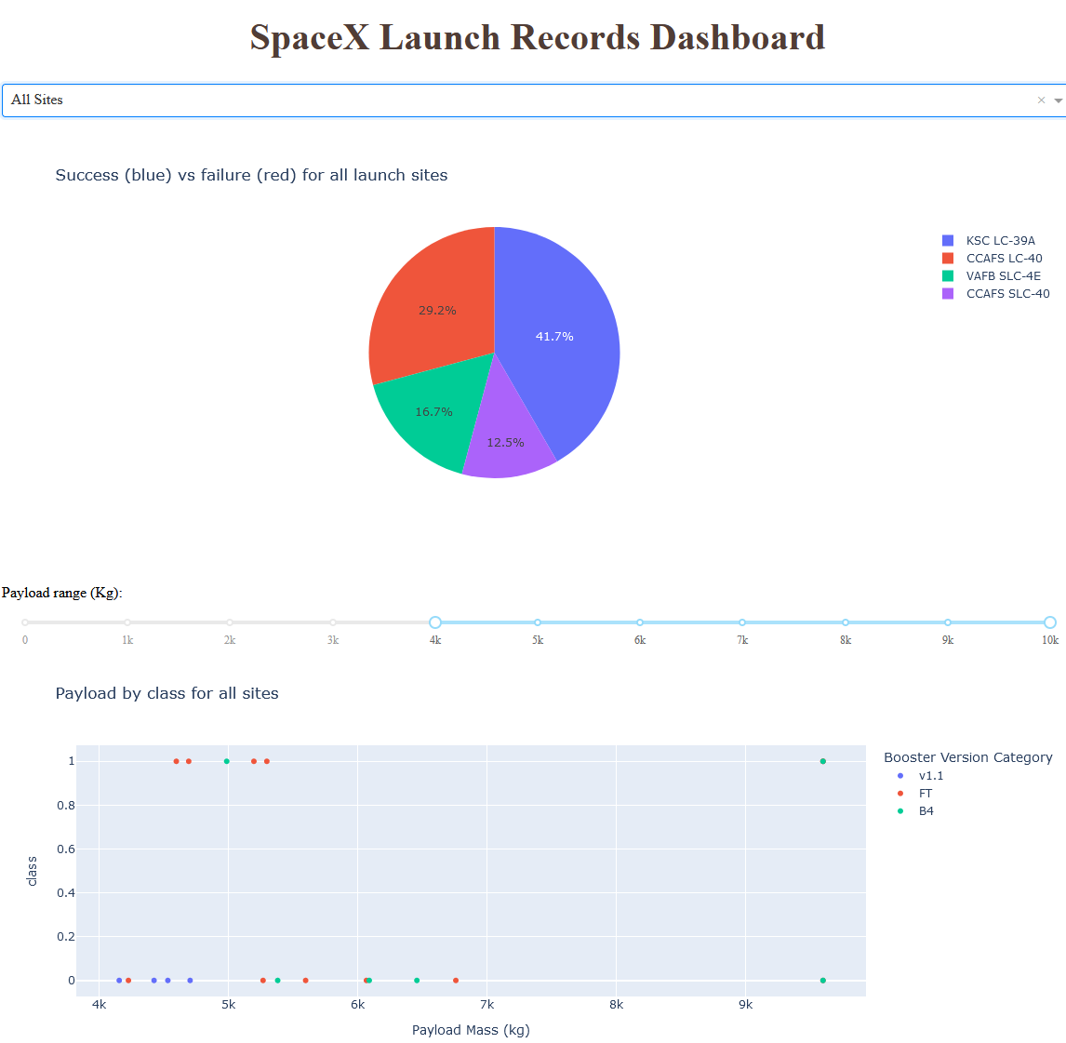
Build a Dashboard with Plotly Dash
An interactive dashboard was built with Plotly dash to show
Pie charts showing the total launches by specific sites
Scatter plots showing the relationship between payload mass and outcome for specific booster versions
GitHub URL of the completed dashboard code https://github.com/elmi3/ibm_capstone/ blob/main/spacex_dash_app.py

Slide 15
Predictive Analysis (Classification)
Using NumPy, Pandas, and scikit-learn, I
Preprocessed the data to a useable form (including classification and splitting into training and test sets)
Used the data to train several different ML models, including
Logistic Regression, Support Vector Machine, Decision Tree Classifier, Nearest Neighbor
Evaluated the models using
Confusion Matrices, scikit’s score() function
GitHub URL of the completed interactive map notebook https://github.com/elmi3/ibm_capstone/blob/main/SpaceX_Machine_Learning_Prediction_Part_5.jupyterlite.ipynb

Slide 16
Result
Exploratory data analysis results include
Number of launch sites: 4
Launch sites significant distance away from cities but close to logistic infrastructure and coasts
Improvement in mission success and payload mass over time
First mission: 2010
First successful stage 1 landing: 2015
Most frequent orbits: ISS, GTO & VLEO
Average F9 v1.1 payload mass: 2928kg
Interactive analytics demo ->
Predictive analysis results
Models built and evaluated

Slide 17

Section 2

Slide 18
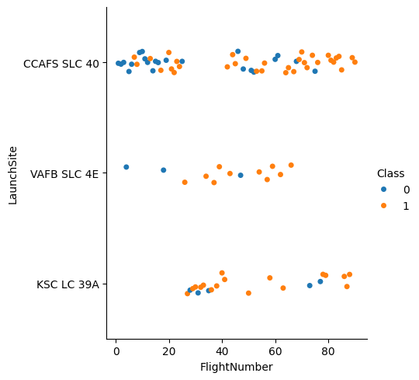
Flight Number vs. Launch Site
Findings:
Most launches from SLC 40
Successful missions (Class: 1) increase with increase in flight number independent of launch site
Launch site SLC 4E is no longer in use

Slide 19
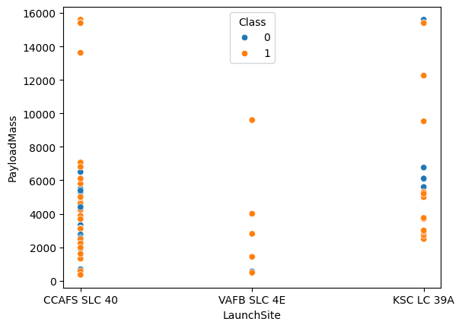
Payload vs. Launch Site
Findings:
Success increased with increased payload mass
Site SLC 4E is not used for payloads over 10t

Slide 20
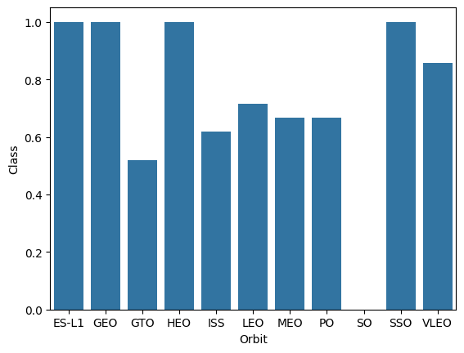
Success Rate vs. Orbit Type
Findings:
ES-L1, GEO, HEO, and SSO have a 100% success rate
SO is the only orbit with 100% failure rate (1 of 1 launches)

Slide 21
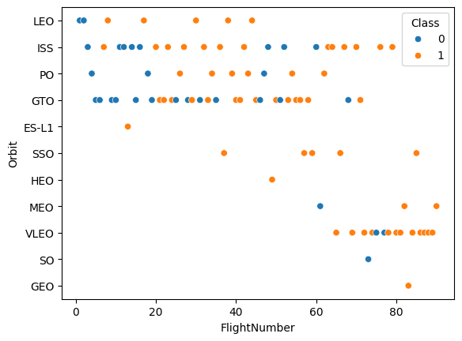
Flight Number vs. Orbit Type
Findings:
Success rate tendentially increases with flight number
VLEO has become a very popular orbit recently
ISS and GTO are the most frequently used orbits

Slide 22
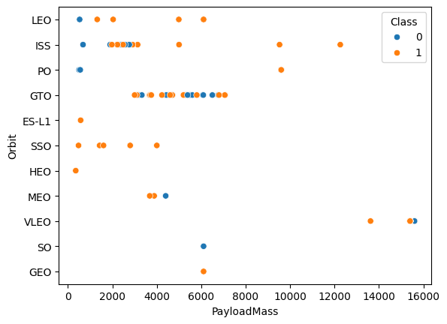
Payload vs. Orbit Type
Findings:
ISS and VLEO are the only orbits with payloads over 7t
Big clusters:
2 – 3t for ISS orbit
3 – 7t for GTO orbit

Slide 23
Launch Success Yearly Trend
Findings:
Steep increase in successful missions between 2013 and 2017
Relatively steady high success rate between 2017 and 2020

Slide 24
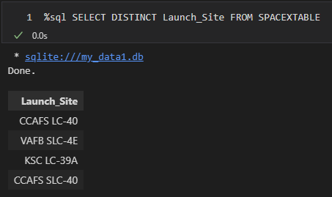
All Launch Site Names
Explanation:
Display the names for all launch sites
Findings:
4 launch sites found:
CCAFS LC-40 (Cape Canaveral AFS Launch Complex 40)
VAFB SLC-4E (Vandenberg Space Launch Complex 4E)
KSC LC-39A (Kennedy Space Center Launch Complex 39A)
CCAFS SLC-40 (Cape Canaveral Space Launch Complex 40)

Slide 25
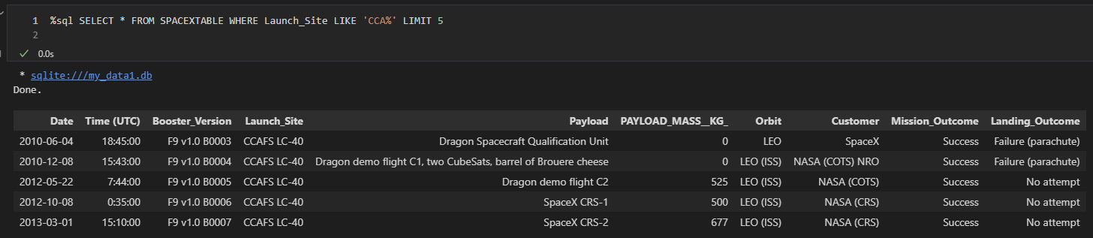
Launch Site Names Begin with 'CCA'
Explanation:
Display 5 records where launch sites begin with the string ‘CCA’

Slide 26
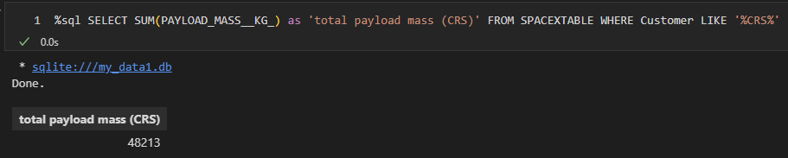
Total Payload Mass
Explanation:
Display the total payload mass carried by boosters launched by NASA (CRS)

Slide 27
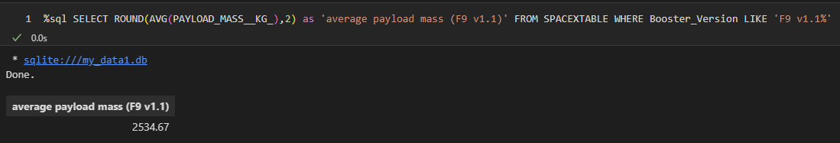
Average Payload Mass by F9 v1.1
Explanation:
Display average payload mass carried by booster version F9 v1.1

Slide 28
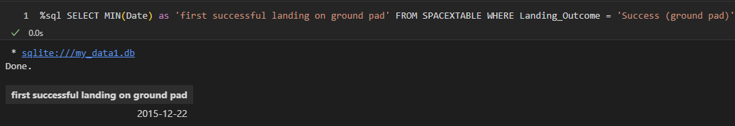
First Successful Ground Landing Date
Explanation:
List the date when the first successful landing outcome in ground pad was achieved

Slide 29
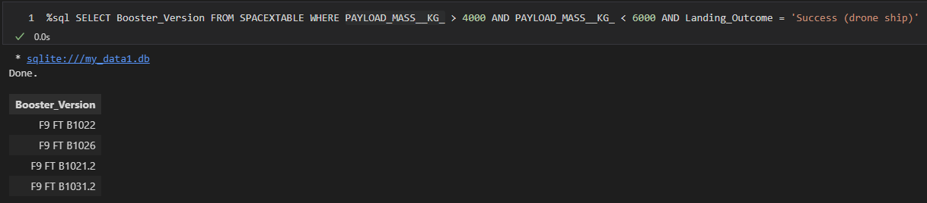
Successful Drone Ship Landing with Payload between 4000 and 6000
Explanation:
List the names of the boosters which have success in drone ship and have payload mass greater than 4000 but less than 6000

Slide 30
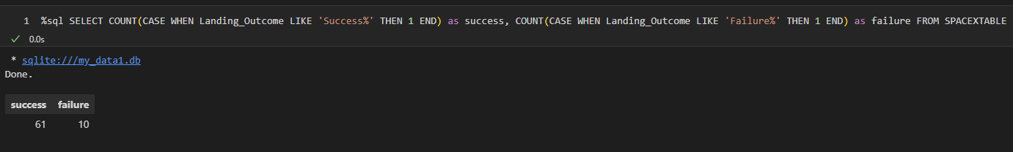
Total Number of Successful and Failure Mission Outcomes
Explanation:
List the total number of successful and failure mission outcomes

Slide 31
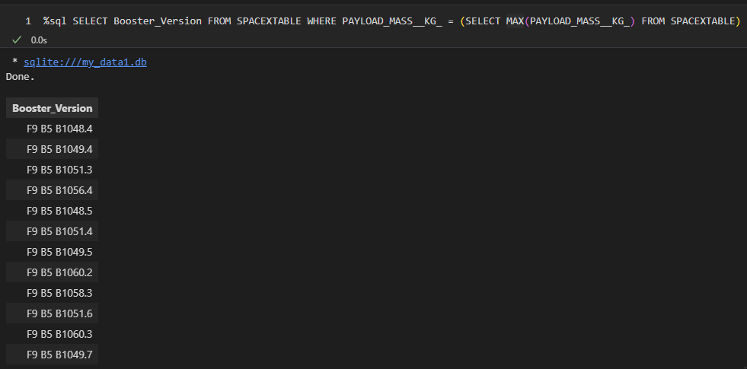
Boosters Carried Maximum Payload
Explanation:
List the names of the booster_versions which have carried the maximum payload mass.

Slide 32
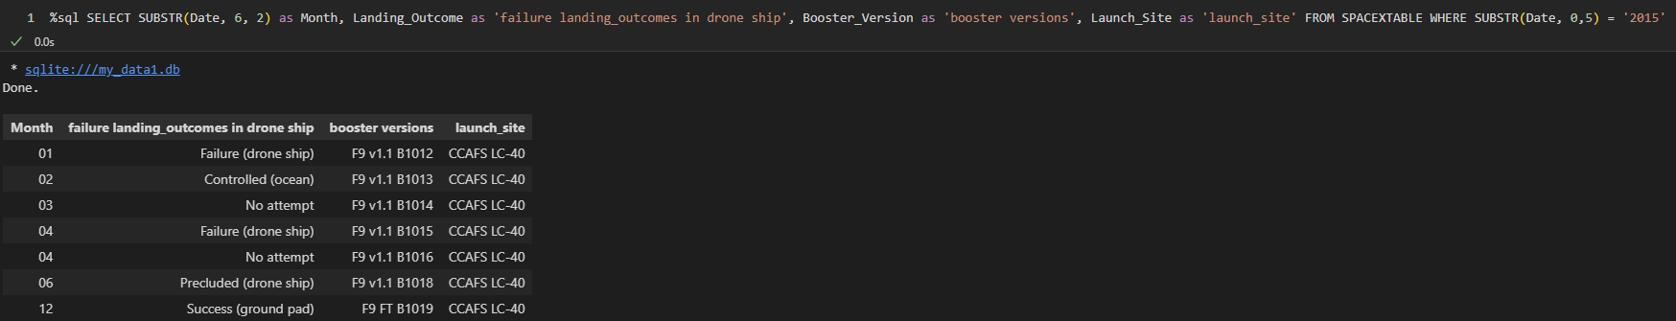
2015 Launch Records
Explanation:
List the records which will display the month names, failure landing_outcomes in drone ship, booster versions, launch_site for the months in year 2015

Slide 33
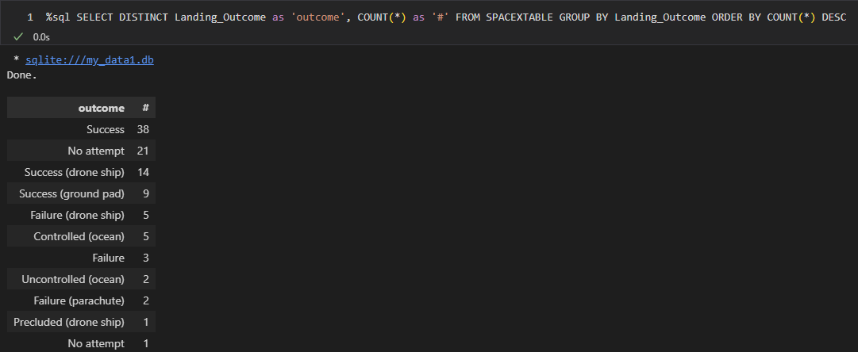
Rank Landing Outcomes Between 2010-06-04 and 2017-03-20
Explanation:
Rank the count of landing outcomes (such as Failure (drone ship) or Success (ground pad)) between the date 2010-06-04 and 2017-03-20, in descending order

Slide 34

Section 3

Slide 35
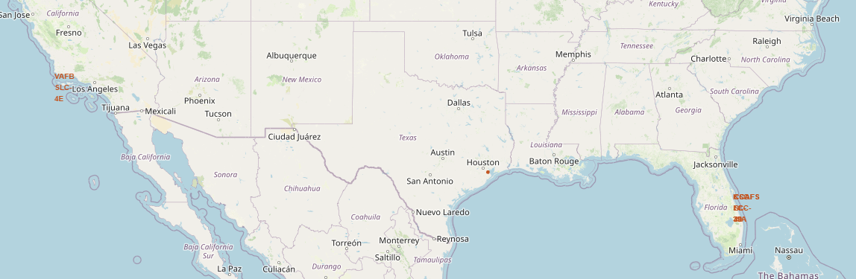
SpaceX launch sites
Findings:
All locations close to the ocean and in the USA

Slide 36
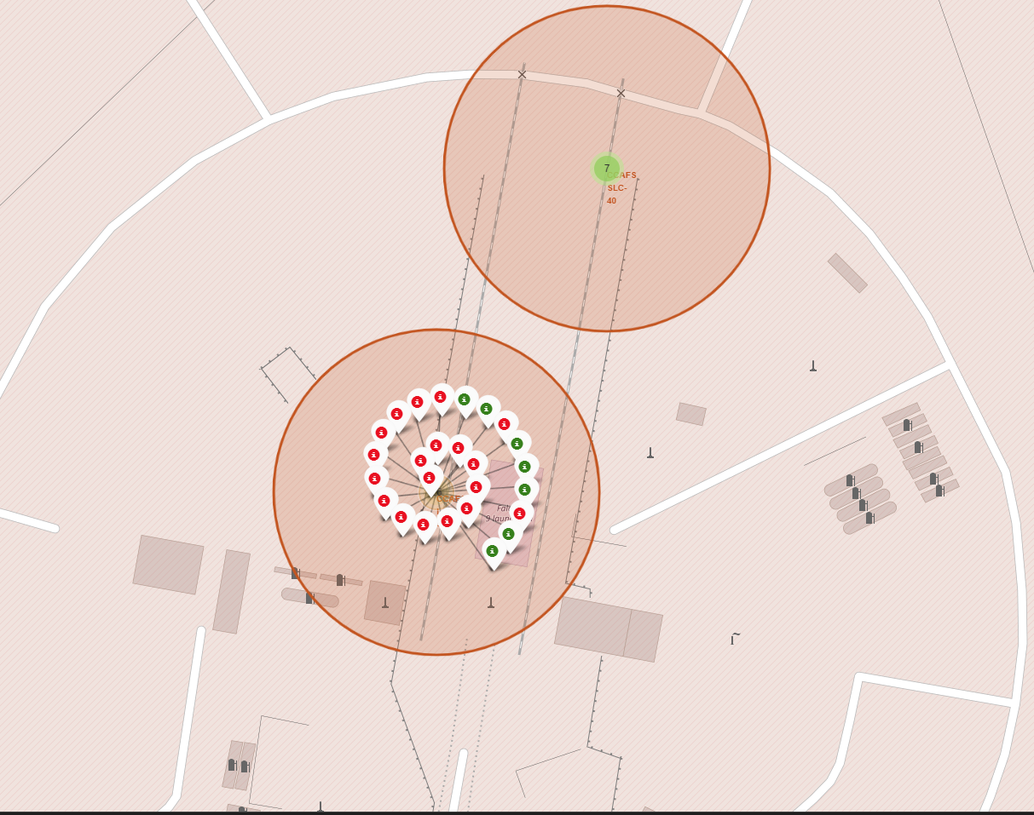
Launch outcome color labels
Red labels for failures, green for successes
Shown for CCAFS LC-40

Slide 37
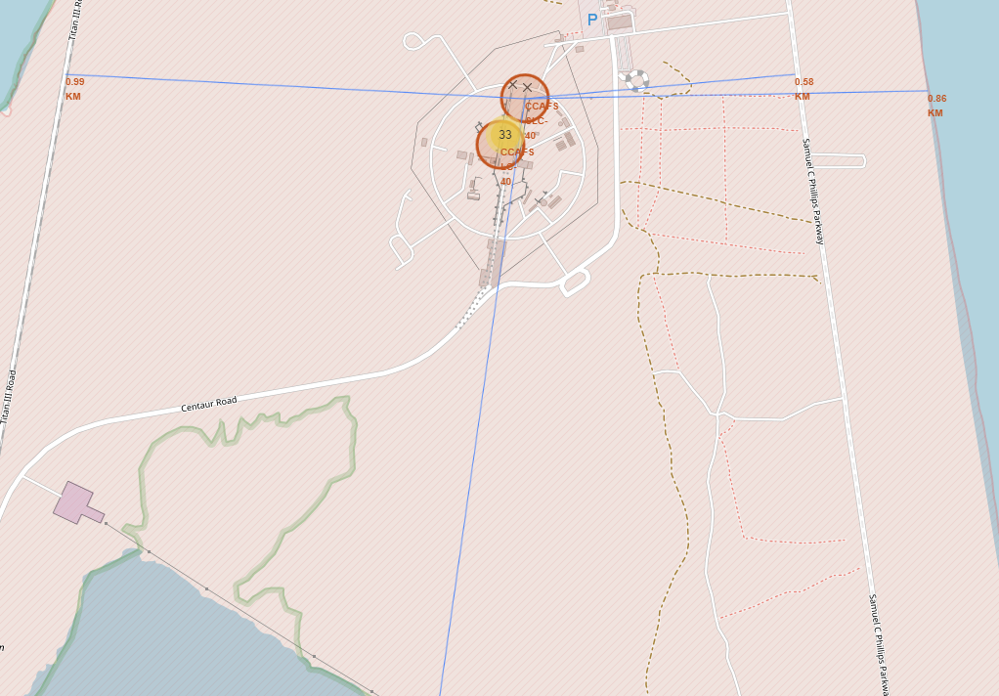
Distances to Infrastructure
Lines with distance labels to relevant infrastructure:
Left: railroad
Right: highway and ocean
Bottom: city (cut off)

Slide 38

Section 4

Slide 39
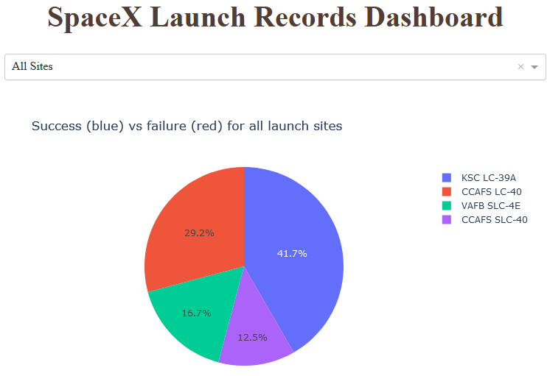
Dashboard: Launch success for all sites
Launch successes for all 4 sites shown.
KSC LC-39A and CCAFS LC-40 launched most successes

Slide 40
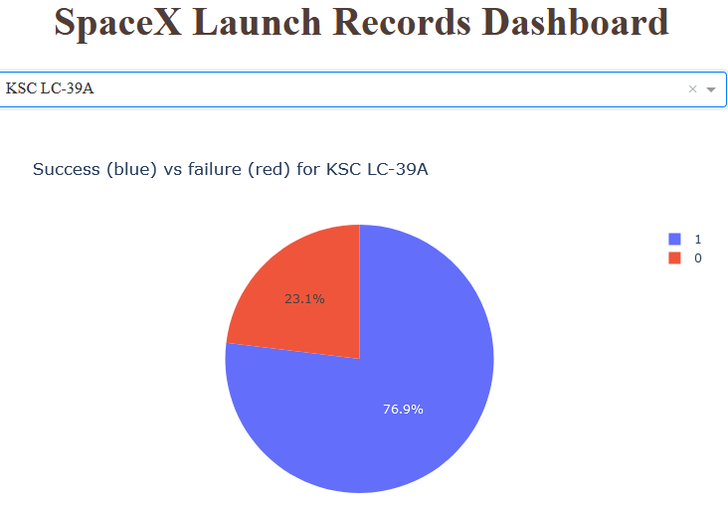
Dashboard: KSC LC-39A details
Pie chart for KSC LC-39A
10 successes (76.9%)
3 failures (23.1%)

Slide 41
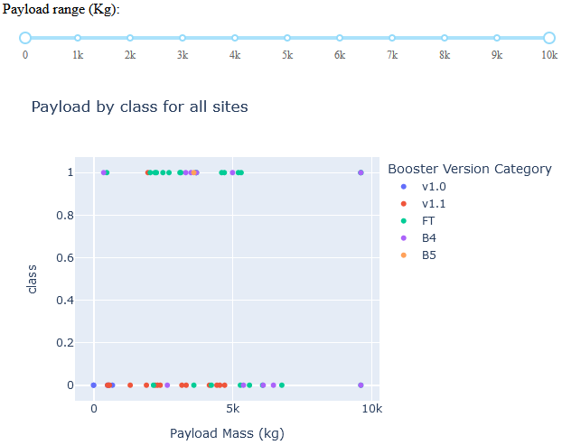
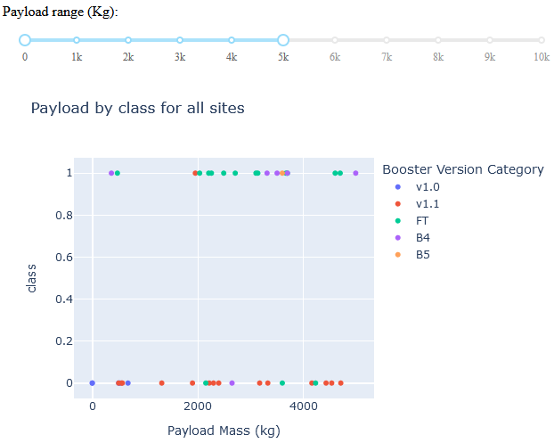
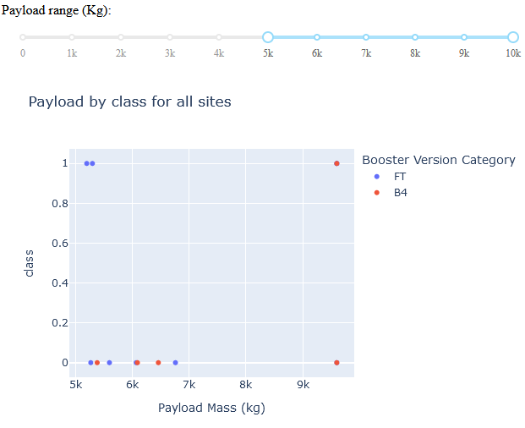
Dashboard: Different payloads for all sites
Total range (0 – 10t) lower range (0 – 5t) upper range (5 – 10t)

Slide 42

Section 5

Slide 43
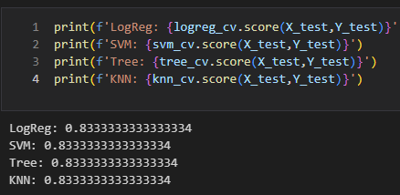
Classification Accuracy
All models have identical accuracy

Slide 44
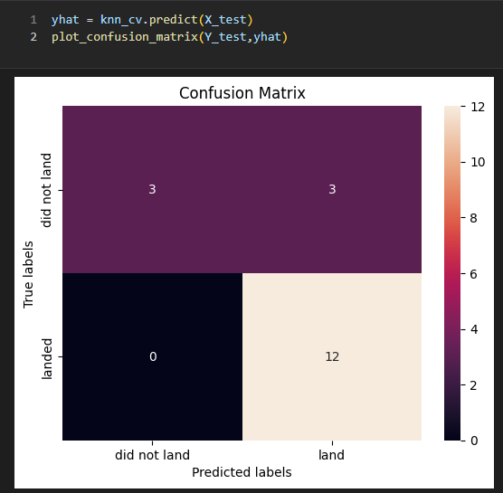
Confusion Matrix
Confusion matrix for KNN
15 hits
3 false positives
0 false negatives

Slide 45
Conclusions
Conclusions for Classification
ML models can be used to classify launches with decent accuracy
The chosen model is not relevant

Slide 46
Appendix
Link to entire github repository (all used files) https://github.com/elmi3/ibm_capstone

Slide 47


